Slide 1


Ground Fault Detection and Insulation Monitoring
Distribution System Design
Revision of 15 October 2026
Dr. Norbert Doerry
http://doerry.org/norbert/MarineElectricalPowerSystems/index.htm
© 2026 by Norbert Doerry
This work is licensed via: CC BY 4.0 (https://creativecommons.org/)

Slide 2
Essential Questions
What are ground detection lights? What methods of grounding do they apply? | Understand
What is an insulation monitoring system? What methods of grounding does an Insulation Monitoring system work with? | Understand
What are other methods of detecting a ground fault? | Understand
How are ground faults localized and isolated? | Apply

Slide 3
Grounding methods for shipboard power systems
Ungrounded
  Traditional method used on ac systems with nominal system voltages at or below 1000 volts.
  Recommended option for systems with a nominal system voltage at or below 1000 volts with mission critical equipment.
  Enables operation with a single line-to-ground fault.
  Susceptible to damaging transients from intermittent ground faults.
High Resistance Grounded
  Recommended for use on ac and dc systems with nominal system voltages above 1000 volts.
  Recommended option for systems with a nominal system voltage at or below 1000 volts with mission critical equipment.
  Enables operation with a single line-to-ground fault.
  Much less susceptible to damaging transients from intermittent ground faults as compared to ungrounded systems.
Solidly grounded
  Recommended for use on ac and dc systems with nominal system voltages below 1000 volts and supplying only non-vital loads.
  Improves compatibility with equipment designed for terrestrial power systems.

Slide 4
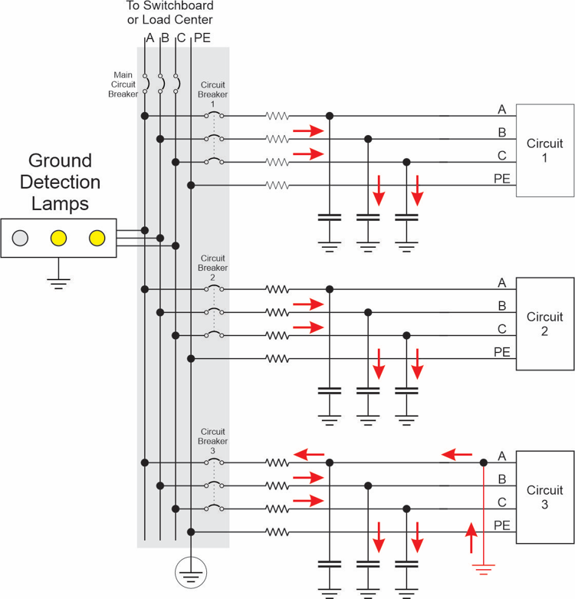
Ground faults – ungrounded systems
Under normal conditions, very little current flows in the hull.
  Parasitic capacitances are more or less balanced.
In a ground fault, fault current:
  Flows through the distributed parasitic capacitances to ground of the unfaulted phases.
  Flows through the ship’s hull.
  Returns via the faulted phase through the ground fault.

Slide 5
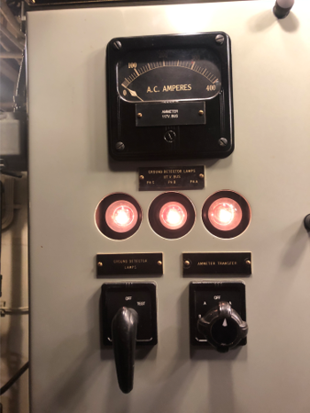
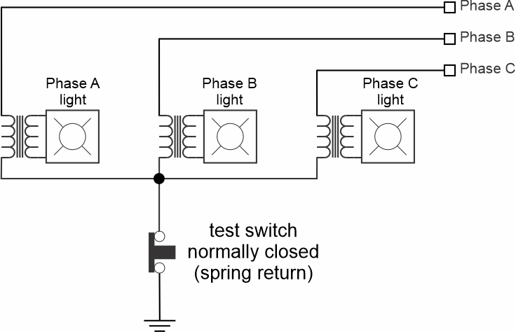
Ground fault detection – ungrounded systems
Ground detection lamps
Three lamps connected in wye
Common point connected to ground via a normally closed switch
Three lamps are dimly lit (line-to-neutral voltage) when no ground fault
If a ground fault is present
  Fault phase lamp extinguishes
  Unfaulted phase lamps are brightly lit (line-to-line voltage)
Test switch disconnects connection to ground to test lamps
  All lamps should be dimly lit
USS Slater (DE-766) Ground Detection Lamps
(Photo by Norbert Doerry: CC BY 4.0)

Slide 6
Ground fault detection – ungrounded systems
Insulation monitoring devices
Estimates the resistance of the insulation for each phase.
  Injection of voltages and currents and measuring response.
If the insulation resistance falls below a preset value, the operator is notified.
  Can identify failing insulation before an actual ground fault occurs.
Insulation monitoring systems and ground-detection lamps are not compatible.
  Line-to-ground impedance of the lamps is likely low enough for the insulation monitoring system to interpret the impedance as failing insulation.

Slide 7
Ground fault detection – ungrounded systems
Line-to-ground voltage measurement
Detect ground faults by directly measuring each of the three-phase line to ground voltages.
  Calculate the neutral voltage.
  If differs significantly from ground, have a ground fault.
If impedance of the voltage sensors are not high enough, may interfere with insulation monitoring devices.

Slide 8
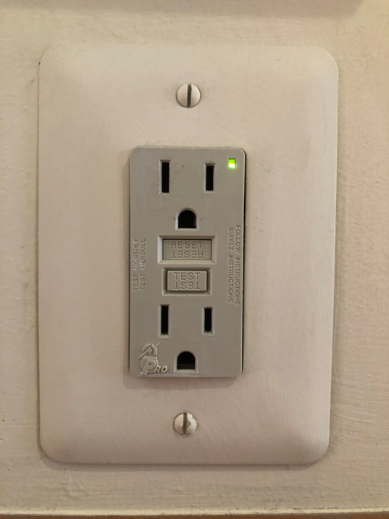
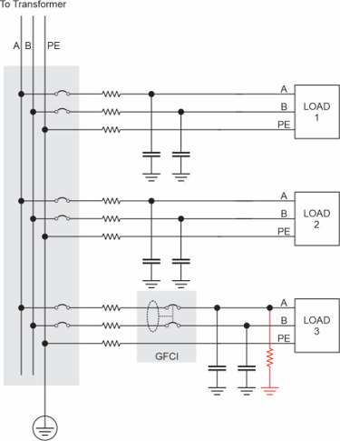
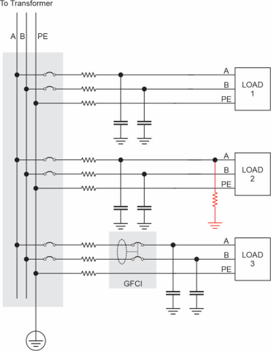
Ground fault detection – ungrounded systems
Ground fault circuit interrupter (GFCI)
Measures common-mode(CM) current.
Trips if CM current too high.
Similar to:
  Residual Current Detector (RCD)
  Combination of an RCD and miniature circuit breaker (RCBO)
  Appliance Leakage Current Interrupter (ALCI)
Will only trip if the fault current from the parasitic capacitances is high enough.
Can inappropriately trip if the line-to-ground capacitance of GFCI protected circuit is large and ground fault in on a different cable.

Slide 9
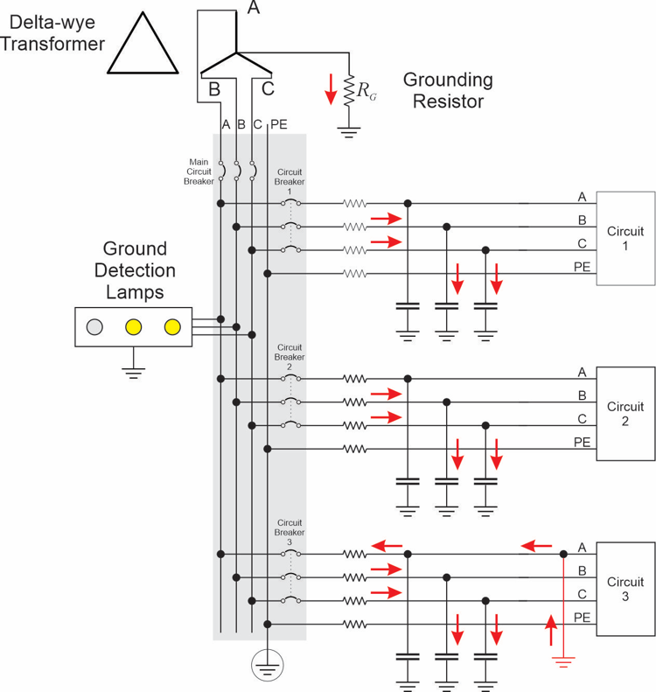
Ground fault detection – high resistance grounded systems
Ground detection lamps
Work in same way as for ungrounded systems.
  Grounding resistor provides additional path for ground fault current.

Slide 10
Ground fault detection – high resistance grounded systems
Voltage and current measurements on grounding resistor
Measure current through and voltage across grounding resistor.
  Under normal conditions, both should be near 0.
  If a ground fault is present, both should not be 0.
  Only one being 0 is an indication of a failure in the grounding resistor.
If the magnitude of the current and voltage is above a threshold, the operator is notified.

Slide 11

Ground fault detection – high resistance grounded systems
Line-to-ground voltage measurements
Work in the same way as for ungrounded systems.
Need not be concerned about impedance of voltage sensor.
  Insulation Monitoring Devices are not compatible with high resistance grounded systems.

Slide 12
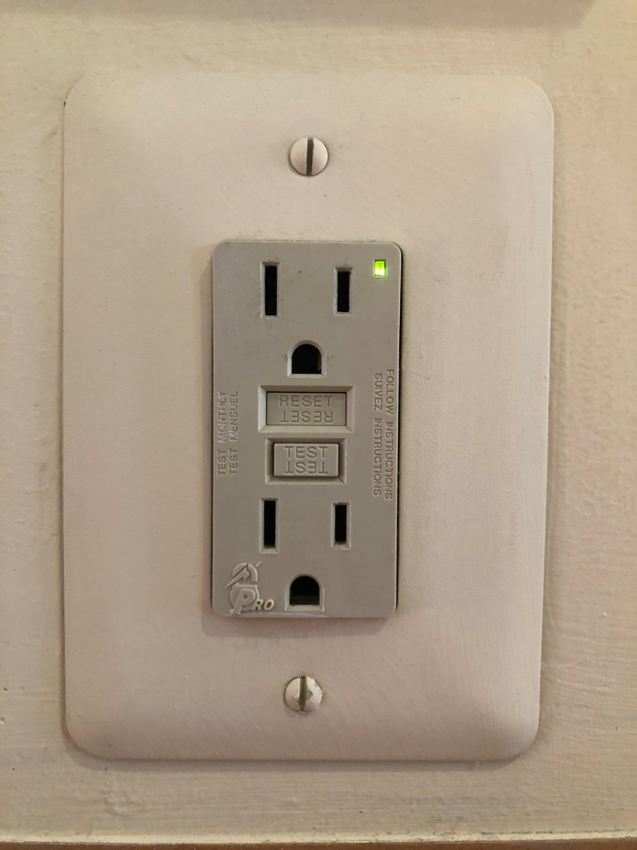
Ground fault detection – high resistance grounded systems
GFCI
Work about the same as in ungrounded systems.
Grounding resistor provides additional ground current.
  More likely that there will be sufficient ground fault current on a faulted circuit to trip the GFCI.
Keeping line-to-ground capacitance on the GFCI protected circuit is still important.
  Avoid tripping GFCI due to ground fault on a different circuit.

Slide 13
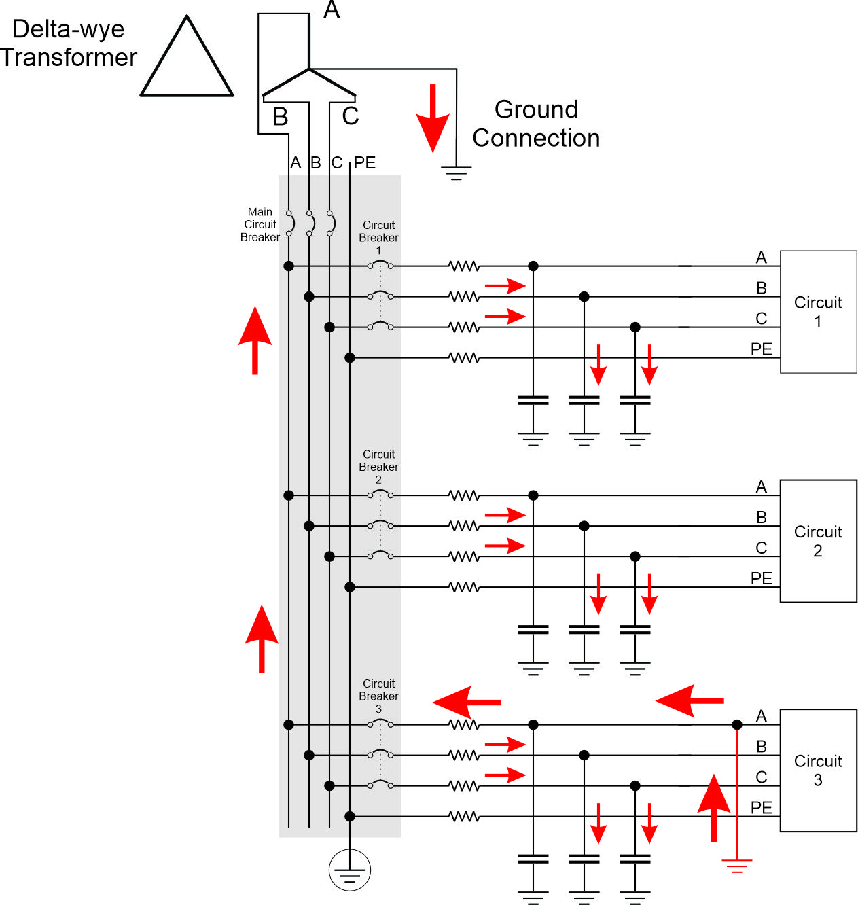
Ground faults in solidly grounded system
Faulted phase results in high fault currents.
  Limited only by the impedance of cables, source, ground fault, and the ground.
Fault current activates the standard fault protection system for line-to-line faults.
Cannot delay fault response to better accommodate operational conditions.

Slide 14
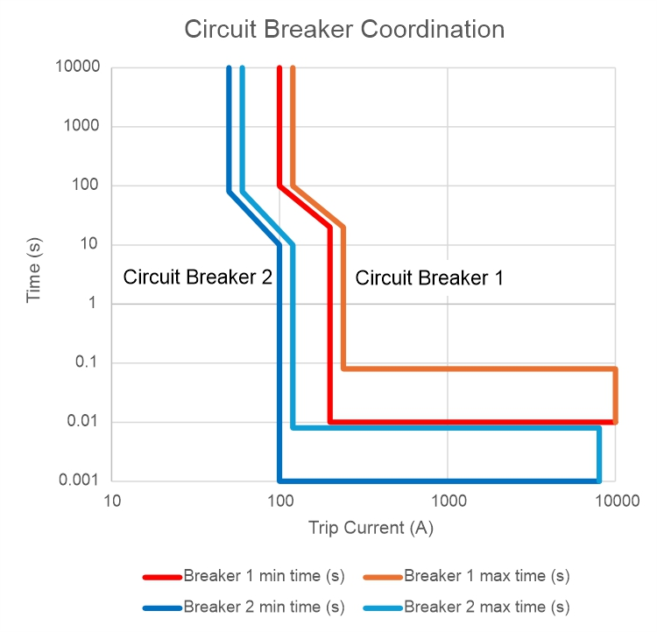
Ground fault detection – solidly grounded systems
Coordinated circuit breakers
Grounds are detected, localized, and isolated at the same time.
Coordinated circuit breakers help ensure the circuit breaker “closest” to the fault on the supply side trips.
  Minimizes number of loads impacted.
  Achieved by the time vs trip current of series connected circuit breakers.

Slide 15
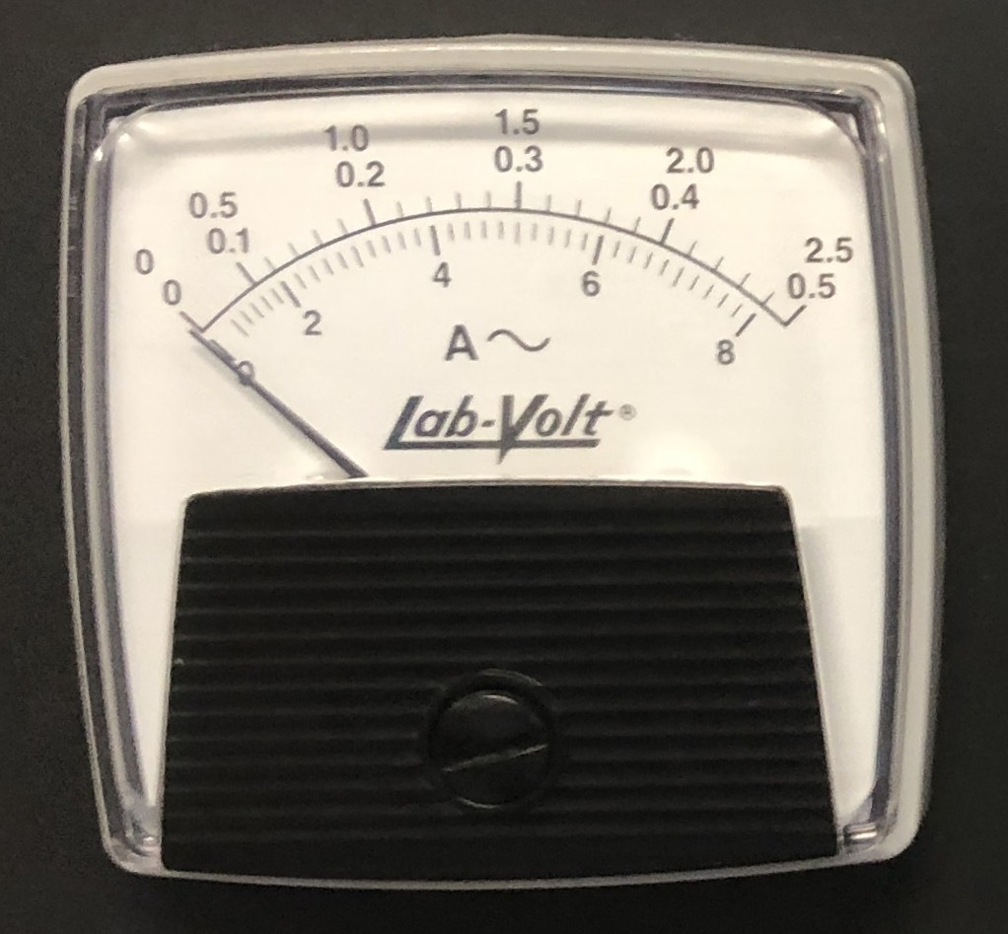

Ground fault detection – solidly grounded systems
Current meter on ground connection
In an unfaulted condition, little if any current flows in the ground connection.
  Parasitic capacitances are more or less balanced.
Current flows through the ground connection during a ground fault.
A high impedance ground fault can still be detected by the current meter even though it is not sufficiently high to trip the circuit breakers.

Slide 16
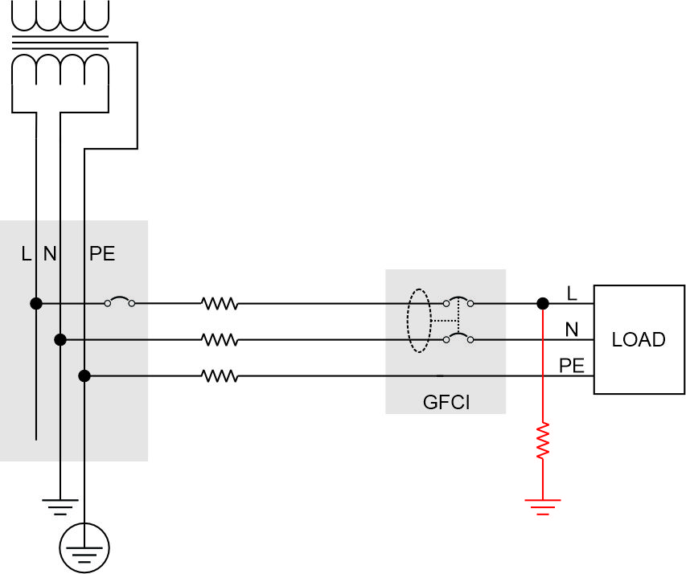
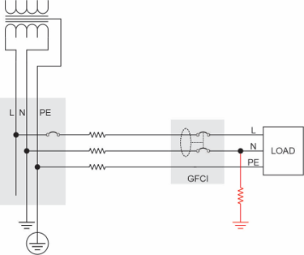
Ground fault detection – solidly grounded systems
GFCI
In a solidly grounded120 V Distribution system, one conductor is grounded (N) while one operates at the nominal system voltage (L).
Ground fault on the L conductor results in a current flow through the hull of the ship.
  Results in CM current that depends on the ground fault impedance.
  If CM current too high, GFCI trips.
  Will trip even if the load is off.
Ground fault on the N conductor results in the return current dividing between the N conductor and the ship’s hull (via the ground fault).
  Amount of current that flows in hull (CM current) depends on relative impedance of the N conductor and the path through the hull from the ground fault
  If CM current too high, GFCI trips.
  Will not trip if the load is off.

Slide 17
Ground Fault localization and isolation
Once a ground fault is detected, should find where it is located and then isolate the ground fault.
  Ideally, system would still operate normally until operational conditions enable safely turning off parts of the power distribution system.
  Localization may be:
    Only to the impacted circuit – physical inspection to find the problem, or
    To the equipment or cable location where the ground fault is located.
Some ground fault detection methods also locate and isolate the ground fault.
  Generally, should limit to non-critical or safety applications.
  Examples:
    Solidly grounded systems – coordinated circuit breakers.
    GFCIs.

Slide 18

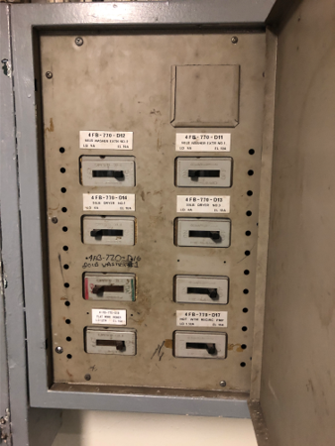
Ground Fault localization and isolation
Ungrounded system – stripping the board
Turn off and on each circuit breaker in sequence:
  If ground fault disappears when the circuit breaker is off, then have found the faulted circuit – turn it back off.
  Fails if more than one circuit has a ground fault on the same phase.
Alternate: Turn all of the circuit breakers off, then turn on each circuit breaker in sequence:
  If a ground fault exists when all the circuit breakers are off, ground fault is in the power panel or in the supply to the power panel.
  If ground fault appears when a circuit is turned on, have identified a faulted circuit – turn it back off.
  Works for multiple faulted circuits.
Both methods can be disruptive to ship operations.
USS Midway (CV-41) Power Panel (Photo by Norbert Doerry CC BY 4.0)

Slide 19
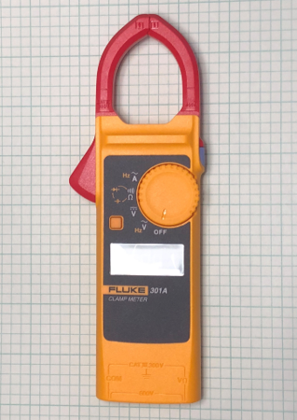
Ground Fault localization and isolation
Ungrounded system – CM current measurement
Use a current meter around all the conductors of a cable to measure the CM current.
The cable for the faulted circuit will likely have the largest CM current.
Along a faulted cable, the CM current should drop significantly at the location of the ground fault.
Fluke 301A Clamp Meter (Photo by Norbert Doerry CC BY 4.0)

Slide 20
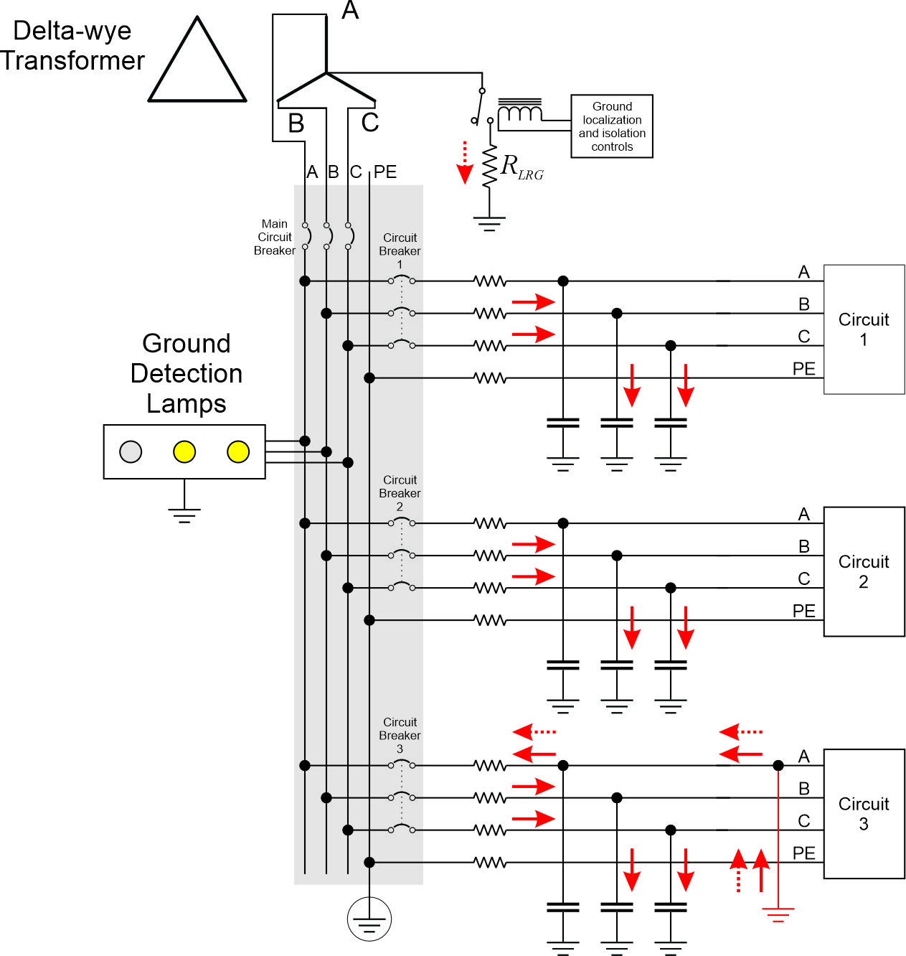
Ground Fault localization and isolation
Ungrounded system – Low resistance grounding
Ground faults can be automatically localized and isolated by inserting a low resistance between the system neutral and ground.
  Resistance is low enough for normal circuit breakers to trip.
  Resistance is high enough to reduce damage to cables and equipment.
Neutral may be obtained from:
  Common connection of wye connected windings.
  Grounding transformer.
System should be activated only when safe to do so within the context of the ship’s operations.

Slide 21

Ground Fault localization and isolation
Ungrounded system – GFCI
Ground faults that the GFCI detects are automatically cleared.
GFCIs in ungrounded systems may have nuisance trips if the protected circuit has significant line to ground capacitance.

Slide 22
Ground Fault localization and isolation
High resistance grounded system – CM current
Works better than for the ungrounded system:
  CM current in the faulted phase includes the current from the ground resistor and should be larger than all unfaulted phases.
  Current phase is different for faulted and unfaulted circuits.
    Unfaulted circuits will largely be capacitive.
    Faulted circuits will have both resistive (from grounding resistor) and capacitive components.

Slide 23
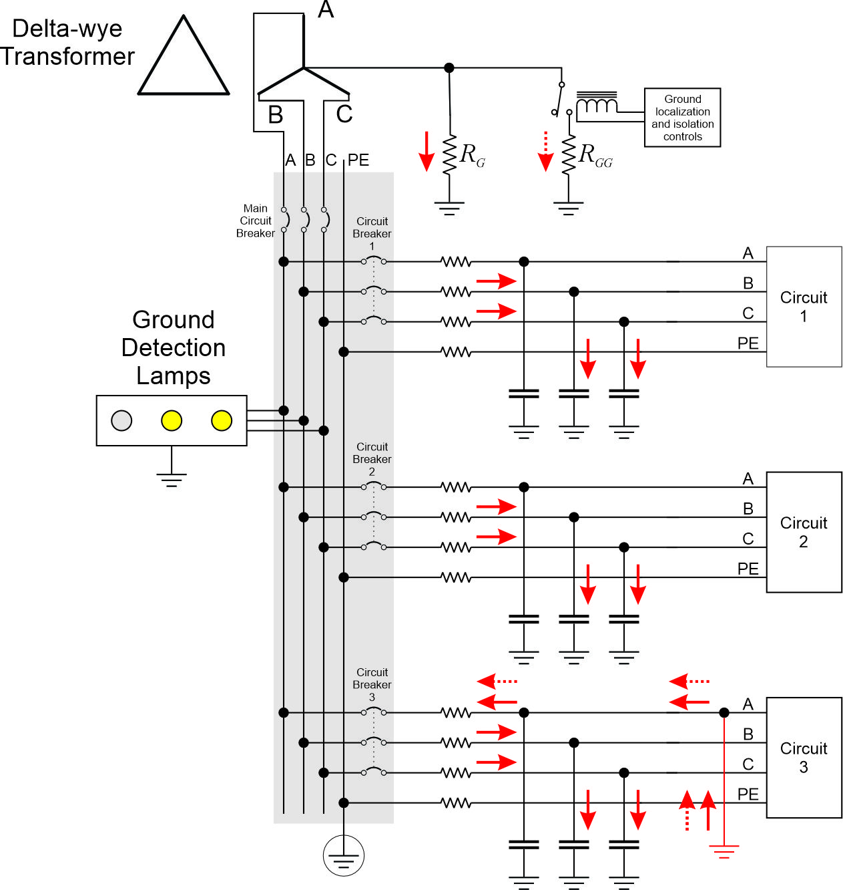
Ground Fault localization and isolation
High resistance grounded system –
Pulsed resistance
A second grounding resistor of higher resistance is periodically inserted in parallel to the grounding resistor Usually about 1 Hz.
  Results in the ground fault current having a square waveform.
  Common mode current of the circuit with the ground fault will show the square waveform.
  Common mode current of the non-faulted circuits will not be significantly impacted by the pulsing ground fault current.
Alternately, a second grounding resistor of resistance low enough for the coordinated circuit breakers to trip is switched in to clear the ground fault.

Slide 24
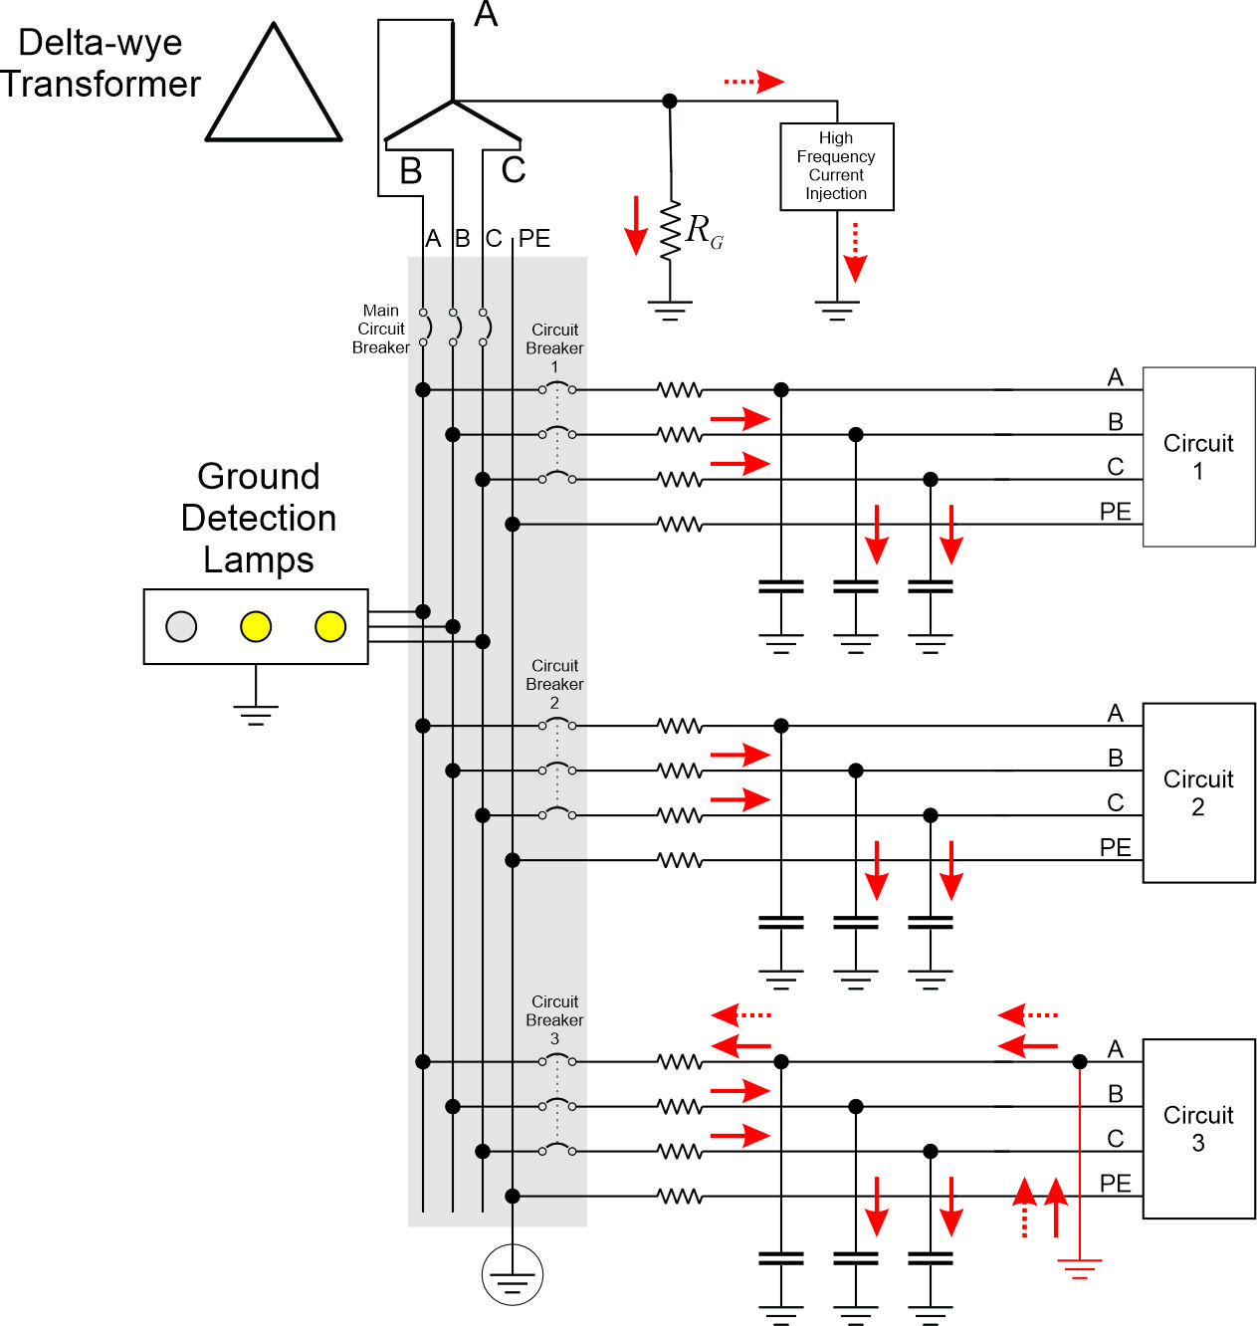
Ground Fault localization and isolation
High resistance grounded system – Injected signal
A high frequency current signal is injected between the neutral and ground.
This signal can be detected by a portable receiver.
The signal will be strongest on the faulted circuit.
The signal can be traced along the circuit until it disappears.
  The ground fault is likely near where the signal disappears.

Slide 25
Ground Fault localization and isolation
High resistance grounded system – GFCI
Ground faults that the GFCI detects are automatically cleared.
GFCIs in high resistance grounded systems may have nuisance trips if the protected circuit has significant line to ground capacitance.

Slide 26
Ground Fault localization and isolation
Solidly grounded system – Coordinated circuit breakers
Ground faults of sufficiently low impedance should result in the supplying circuit breaker closest to the ground fault tripping.
  Automatically clears the ground fault.
  May not occur at an ideal time with respect to ship’s operations.
High impedance ground faults may not produce sufficient fault current to trip the circuit breaker.

Slide 27
Ground Fault localization and isolation
Solidly grounded system – GFCI
Ground faults that the GFCI detects are automatically cleared.

Slide 28
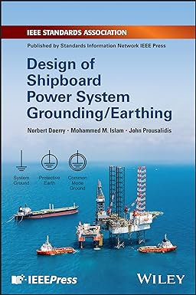
References
IEEE Std 45.1 IEEE Recommended Practice for Electrical Installations on Shipboard--Design
IEEE Std 45.3 IEEE Recommended Practice for Electrical Installations on Shipboard--Systems Engineering
IEEE Std 3003.1 IEEE Recommended Practice for System Grounding of Industrial and Commercial Power Systems
Doerry, Norbert, Mohammed M. Islam, John Prousalidis, Design of Shipboard Power System Grounding / Earthing , IEEE Press - Wiley, January 2025, ISBN-10 1119933080 ISBN-13 978-1119933083

